Slide 1
Data Science
Week 3:
DATA DESTINATION
Lewen and Srikar
Notes:
s

Slide 2
Goals
Understand the information on the table
Analyze data successful and make intuitive and thoughtful inferences
Visualize data through graphs for easy interpretation
Present details of data for better understanding
Notes:
s

Slide 3
Our Interest
Notes:
s&l

Slide 4
Plan
Acquire a quality dataset from Kaggle
Clean using Excel Power Query
Query and extract specific information using Excel Pivot Table
Make hypotheses and analyze data
Create pictorial representation using Google Spreadsheets
Notes:
alternating

Slide 5
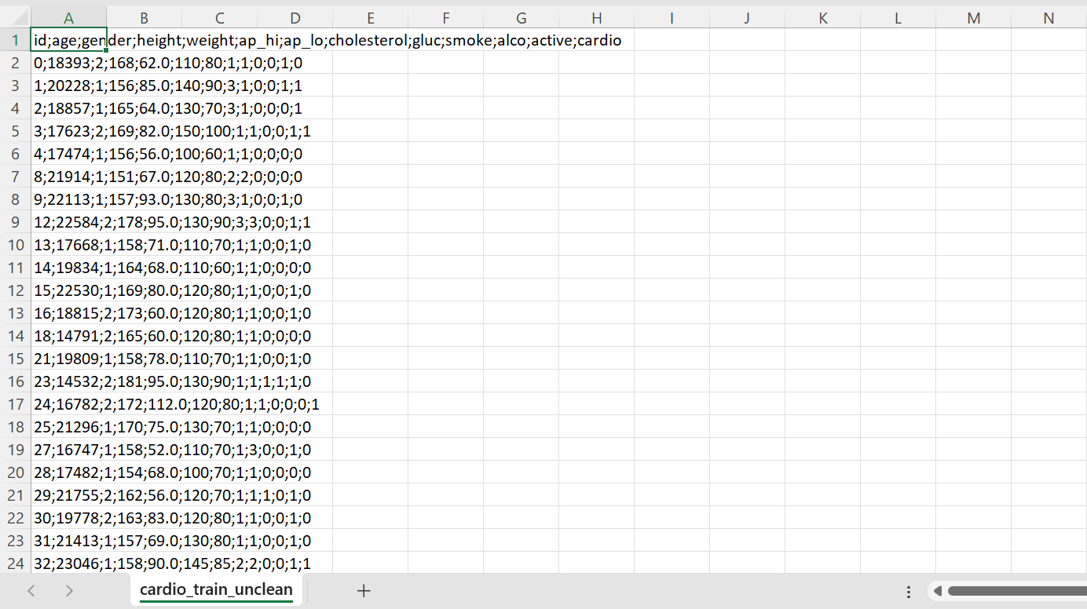
1. Acquire a quality dataset from Kaggle
Notes:
l

Slide 6
2. Clean using Excel Power Query
Notes:
l

Slide 7
3. Query and extract specific information using Excel Pivot Table
Notes:
l

Slide 8
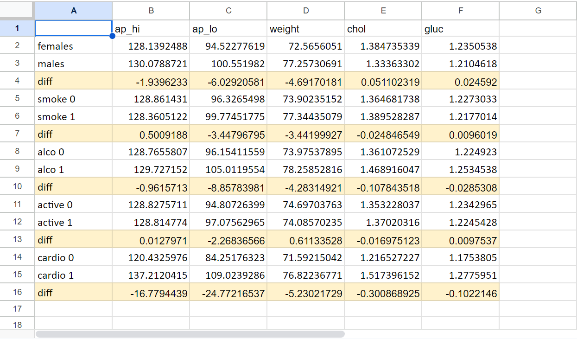
4. Make hypotheses and analyze data
Notes:
l

Slide 9
5. Create pictorial representation using Google Spreadsheets
Notes:
l

Slide 10
Results!
Notes:
s

Slide 11
Causes and Effects
Causes
Effects
Gender
Smoking
Alcohol Consumption
Physical Activity
Cardiovascular Diseases
Blood Pressure (mmHg)
Weight (kg)
Cholesterol Levels (1-3)
Glucose Levels (1-3)
Notes:
s

Slide 12
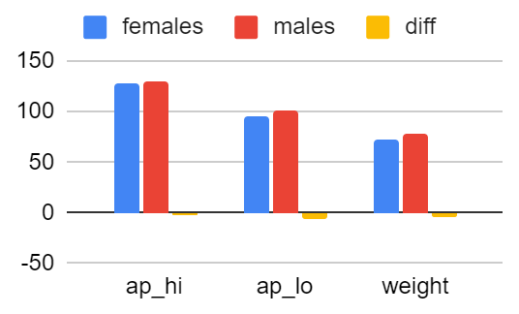
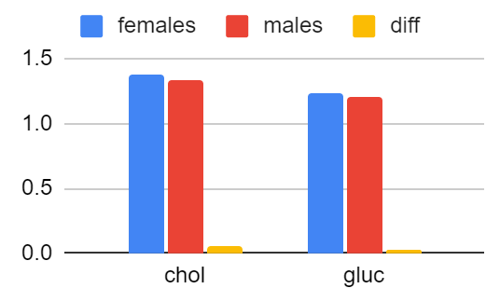
Gender Test
Data
Analysis
Males have more testosterone (higher blood pressure)
Males have bigger heart (slower heart rate)
Males have higher bone density, muscle mass, and height (heavier)
Females have estrogen (more cholesterol)
Notes:
l

Slide 13
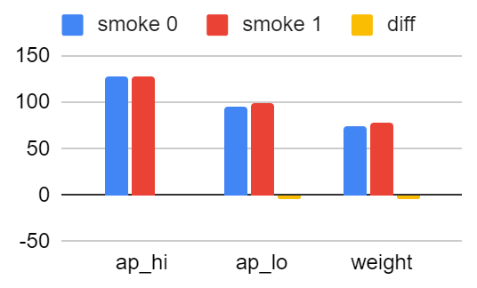
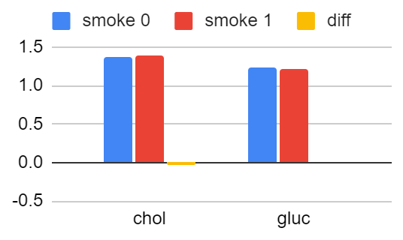
Smoking Test
Data
Analysis
Less harm to the tested body parts
More results if we tested lungs, digestive organs, and bones
Hurts pathogens, body acids, calcium, and alveoli
Smoking still is bad
Notes:
s

Slide 14
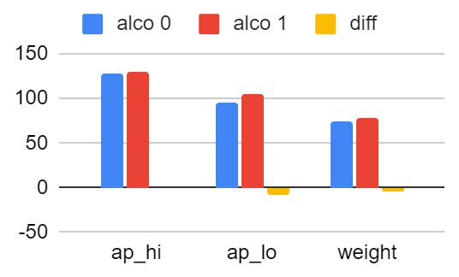
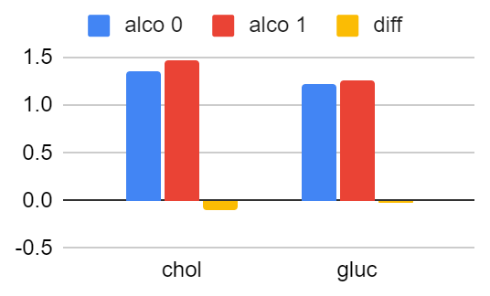
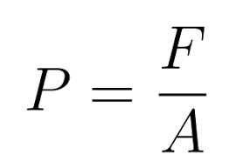
Alcohol Consumption Test
Data
Analysis
Overloads calcium levels (blood vessels constrict)
Doesn’t allow blood and oxygen to flow smoothly
Alcohol broken down in liver and made into cholesterol, triglycerides, and other lipids
Notes:
l

Slide 15
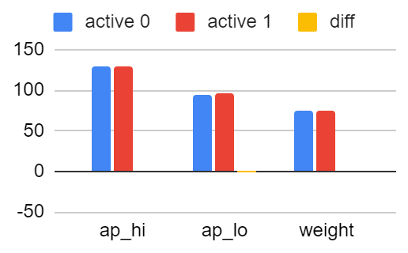
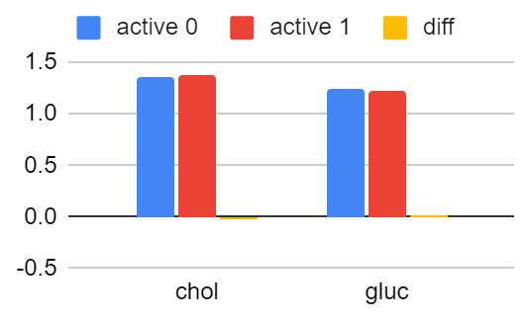
Physical Activity Test
Data
Analysis
Loss of body fat but gain in muscle mass
Muscles are 15% more heavy than fat
Lack of health benefits in the four tests we constructed
Notes:
s

Slide 16
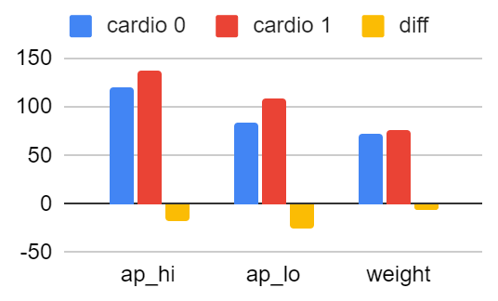
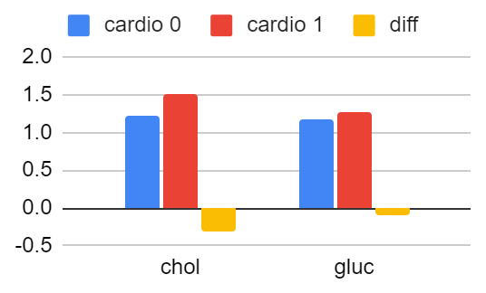
Cardiovascular Diseases Test
Data
Analysis
Effect of Blood Clots
Narrowing of arteries
Oxygen and Blood flow
Causes build up in pressure
Builds up fatty acids
Notes:
l

Slide 17
Conclusion/Final Analysis
Biggest Impact
Cardiovascular Diseases
Alcohol Consumption
Gender
Smoking
Being inactive
Report:
https://docs.google.com/document/d/1R6ikqizsGduw-rqbPeYkS692V1iREqqQytjkybiXFA4/edit
Notes:
s

Slide 18
Resources
https://www.kaggle.com/datasets/sulianova/cardiovascular-disease-dataset?resource=download
https://www.youtube.com/watch?v=0aeZX1l4JT4
https://www.youtube.com/watch?v=p_YP5JiE8sE
https://www.w3schools.com/sql/default.asp
Excel
Replit (5 bucks)
Anosh and Rama!
Notes:
none

Slide 19
Thank you!
Notes:
none

Slide 20
Plan A
Learn SQL
Acquire a quality dataset from Kaggle
Push data set to cloud database
Query and extract specific information using SQL
Make hypotheses and analyze data
Create pictorial representation using R to

Slide 21
Problem with Plan A
Learn SQL
Acquire a quality dataset from Kaggle - Messy dataset
Push data set to a cloud database - No access, expensive
Query and extract specific information using SQL - SQL needs a specific place, unlike Python
Make hypotheses and analyze data
Create pictorial representation using R to - Need to learn R

